Slide 1
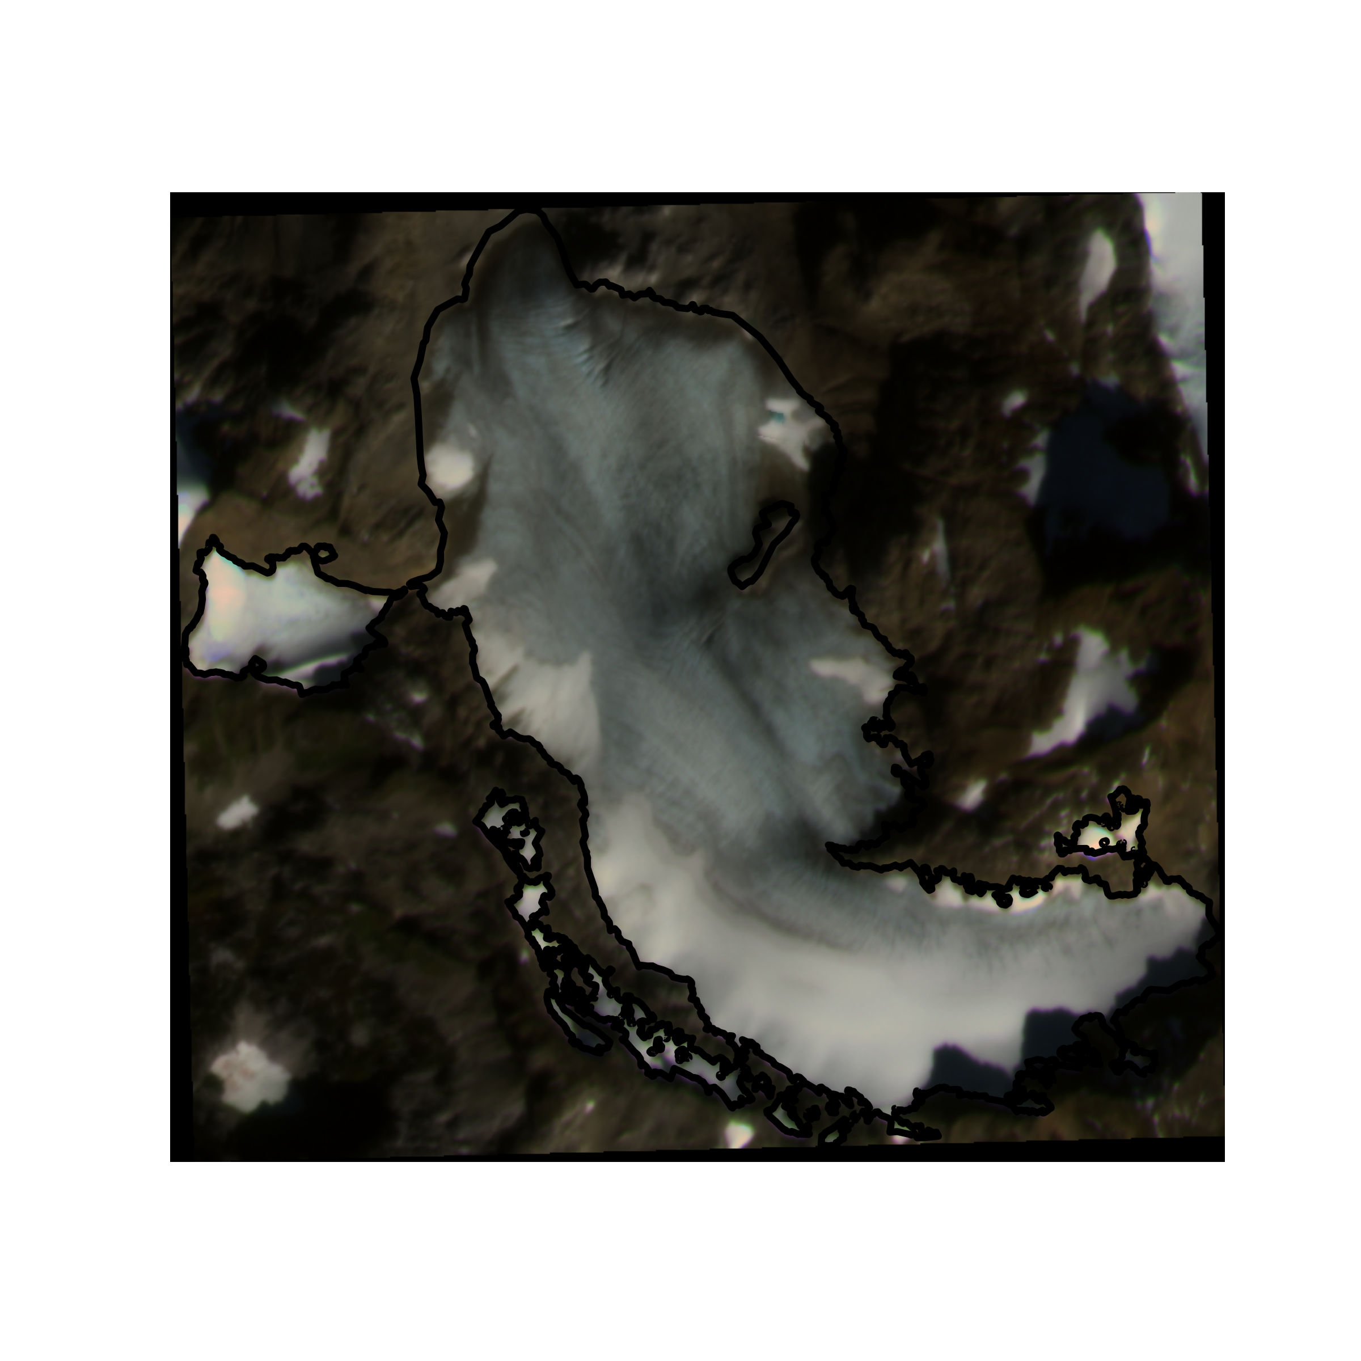
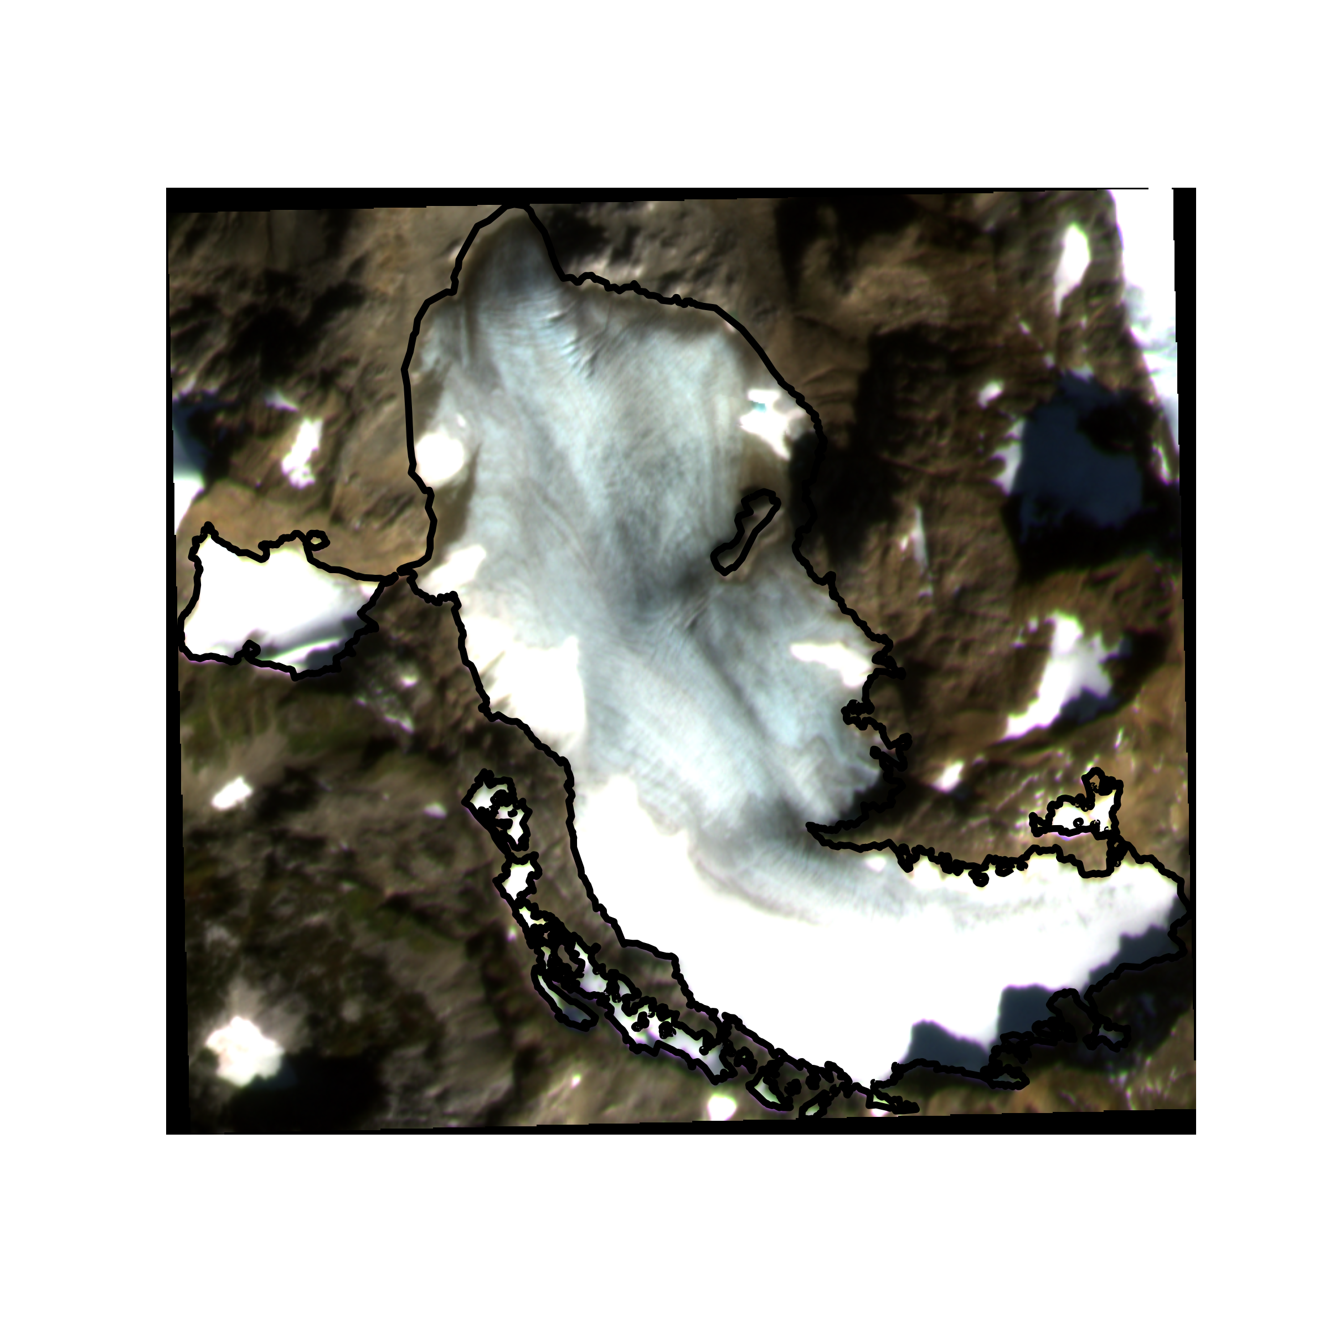
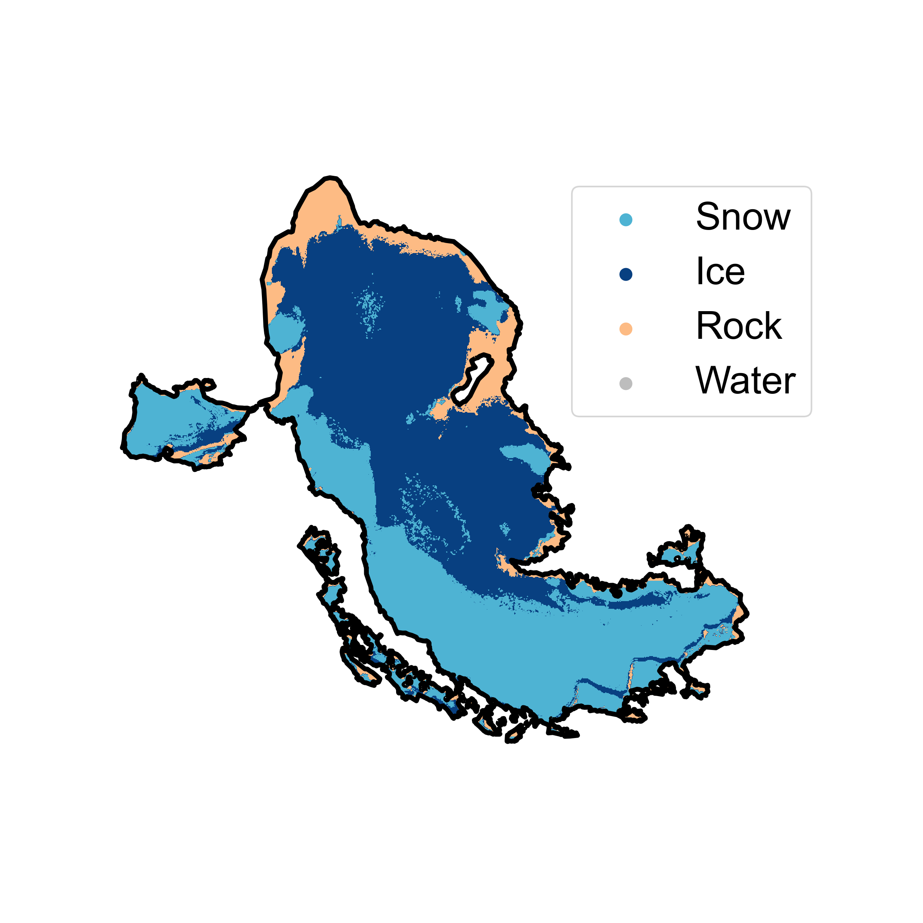
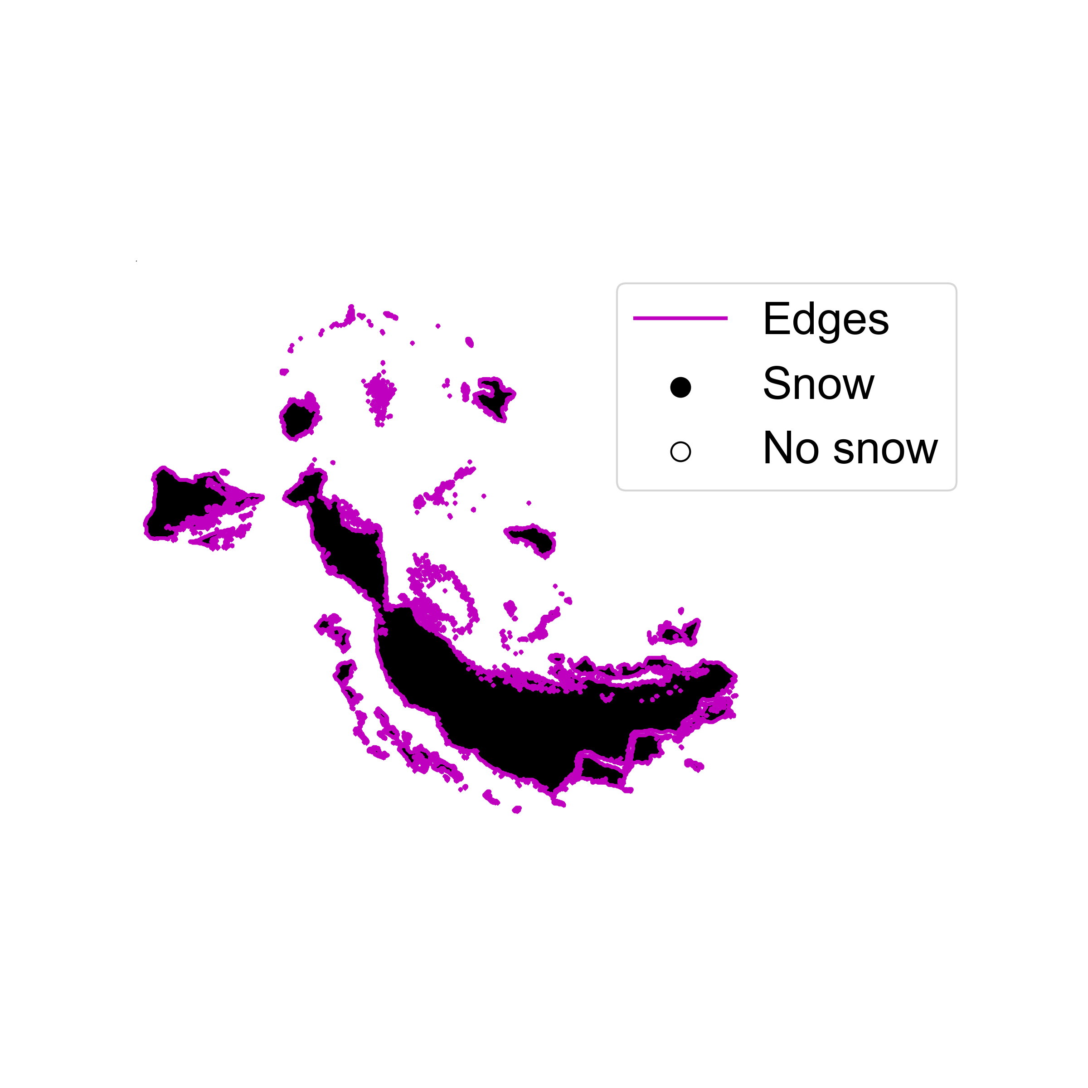
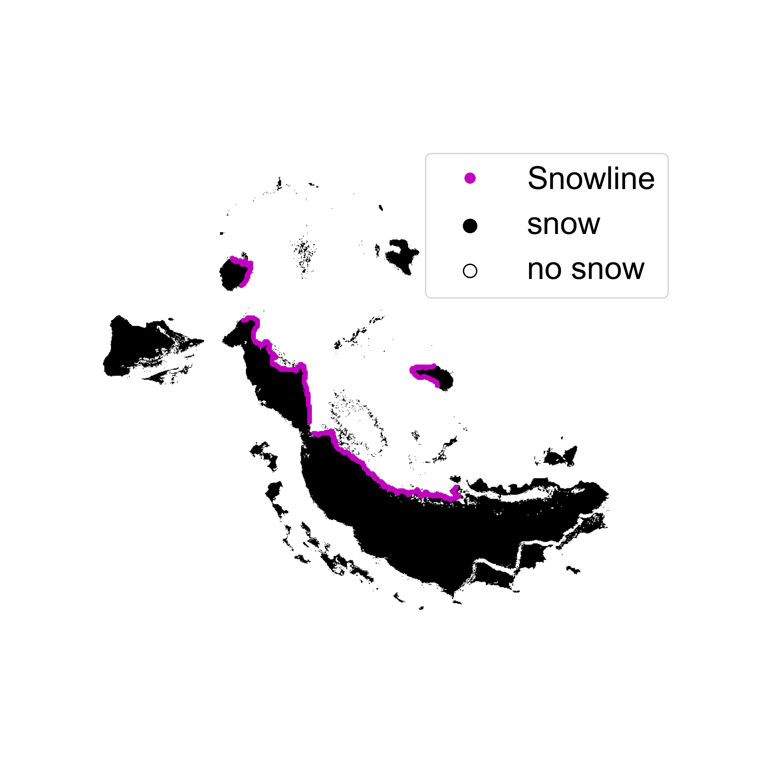
1. PRE-PROCESS
2. CLASSIFY
Landsat 8/9 OLI
Sentinel-2 MSI
PlanetScope 4-band
Filter clouds and cloud shadows
Adjust radiometry
3. IDENTIFY SNOWLINES
Mosaic images captured same day
Classified points
Develop dataset-specific classifiers
Area of Interest
Classify image collections
4. ASSESS ACCURACY
Create binary snow image
Identify edges
Filter edges, identify snowline(s)
Digital Elevation Model
Extract snow-covered elevations
Conduct classification accuracy assessment
Conduct snowlines accuracy assessment

